Slide 1
Chap. 5 The Digital Abstraction
Voltage Levels and the Static Discipline

Slide 2
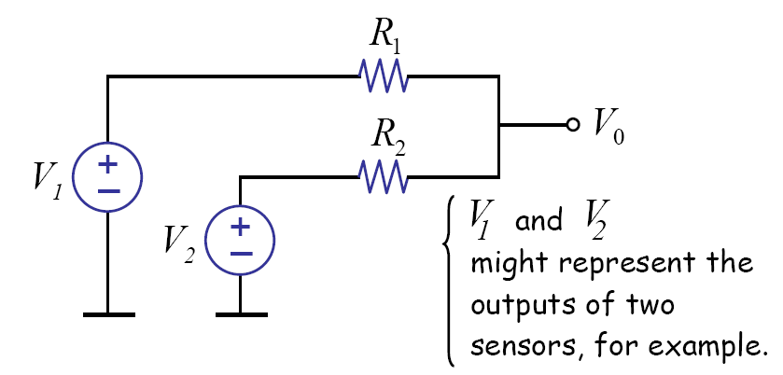
Analog Signal Processing

Slide 3
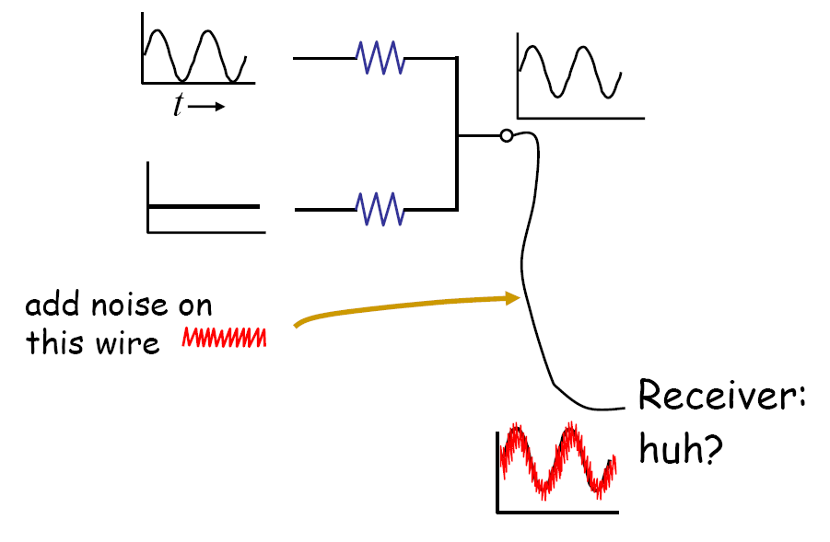
Noise Problem

Slide 4
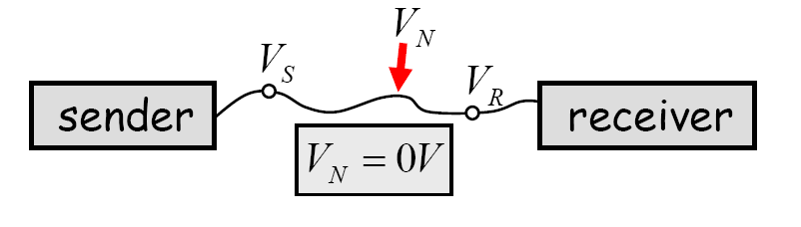
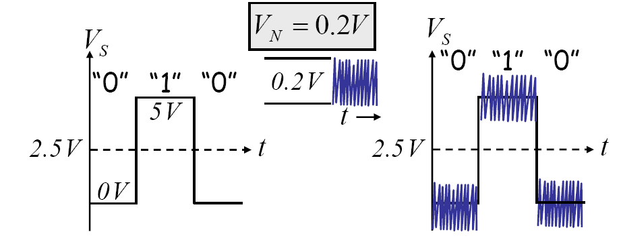
Digital System: Noise immunity !!

Slide 5
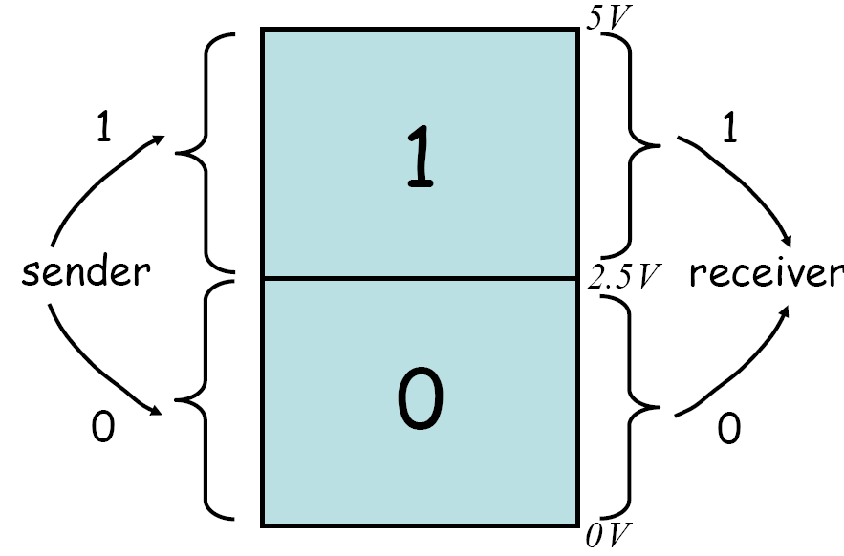
Value Discretization
What about 2.5 V ?

Slide 6
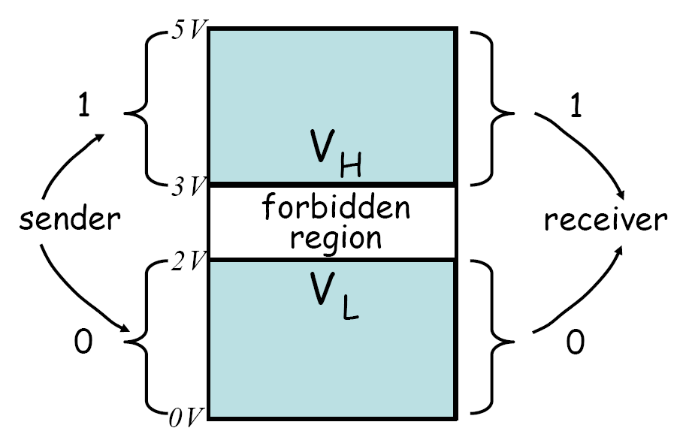
Forbidden Region
Where is the noise margin?

Slide 7
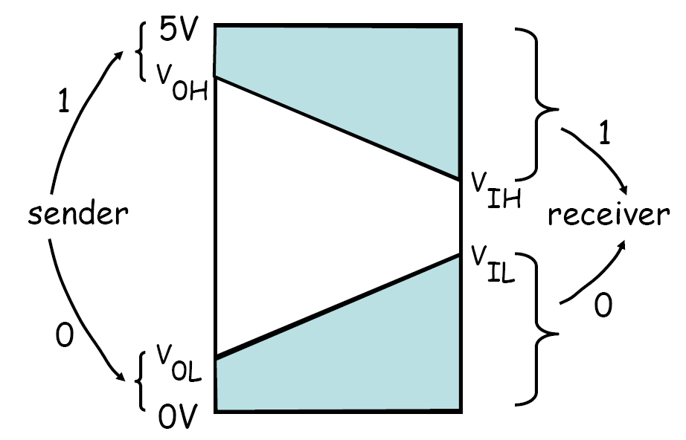
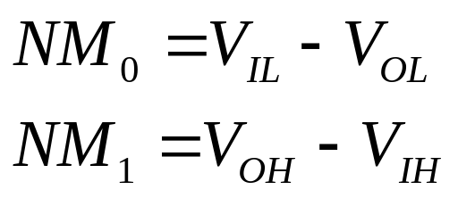
Actual Value Discretization
Noise margin

Slide 8
Static Discipline
If inputs to a digital system meet valid input thresholds, the system guarantees that its outputs will meet valid output thresholds.

Slide 9
Conclusion
Value discretization
Noise margin
Static discipline

Slide 10
Chap. 6 The MOSFET Switches
MOSFET and Switch(S) Model
Static Analysis Using S Model
SR Model of MOSFET
Static Analysis

Slide 11
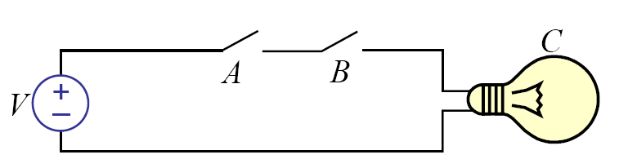
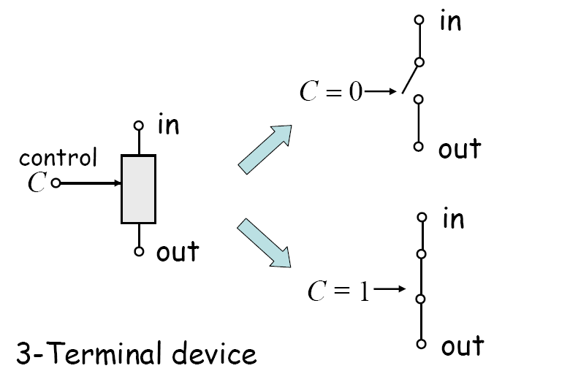
Switch Logic
Key: switch device

Slide 12
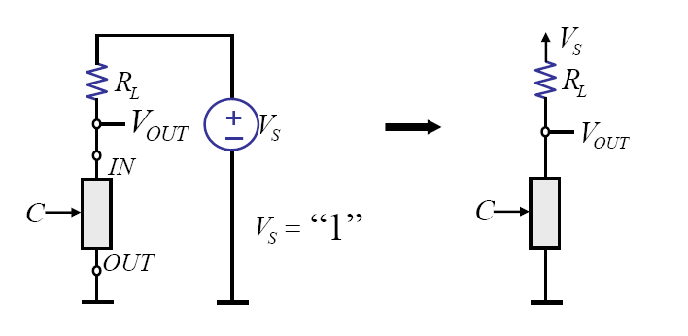
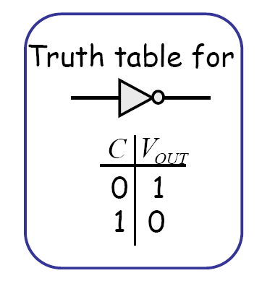
Logic Inverter

Slide 13
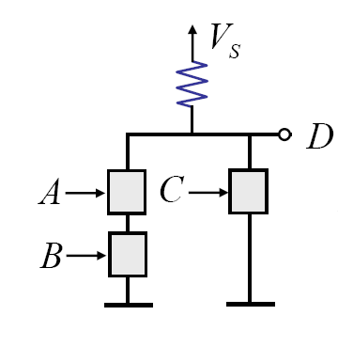
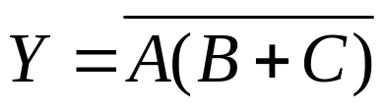
Example
1. Find the logic of this circuit.
2. Draw the following logic circuit:

Slide 14
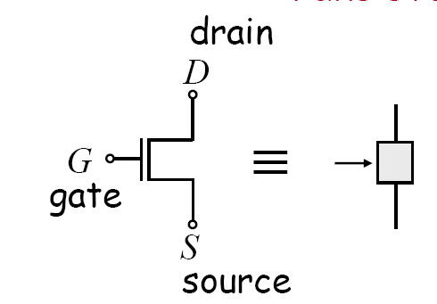
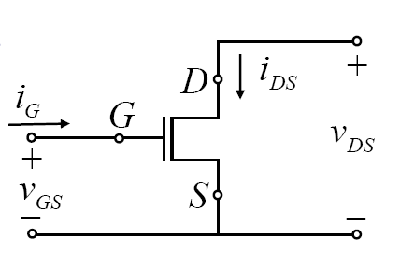
MOSFET
Metal Oxide Semiconductor Field-Effect Transistor

Slide 15
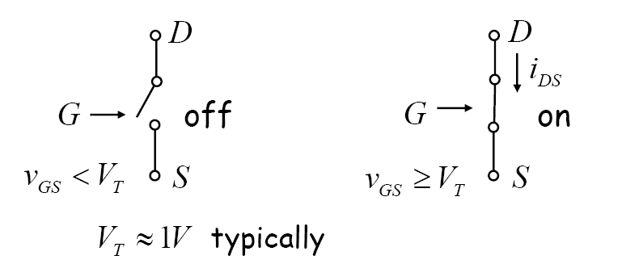
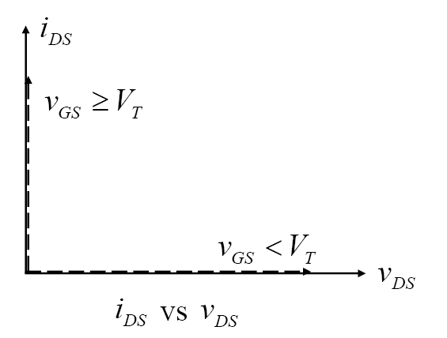
Switch (S) Model of MOSFET

Slide 16
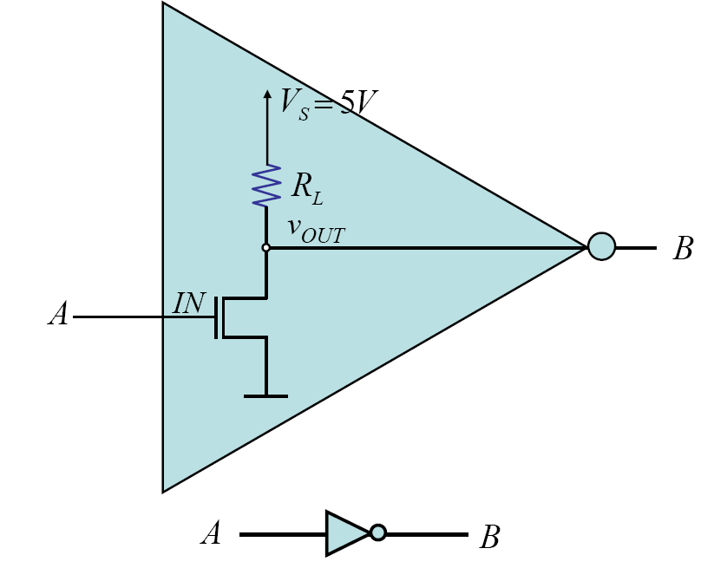
MOS Inverter

Slide 17
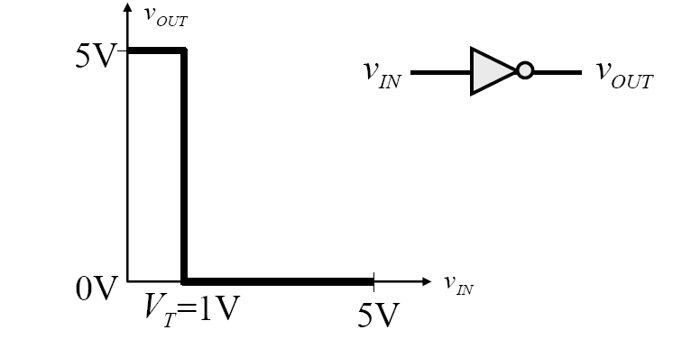
Voltage Transfer Characteristics
Does it satisfy the following static discipline?
  (1)
  (2)

Slide 18
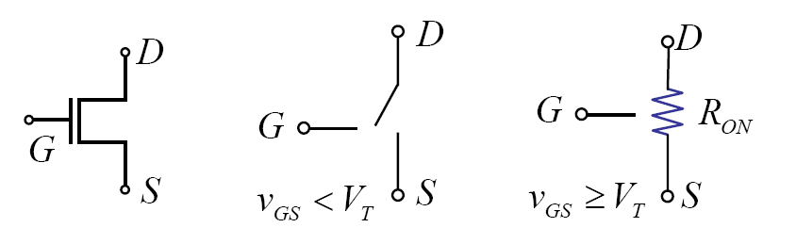
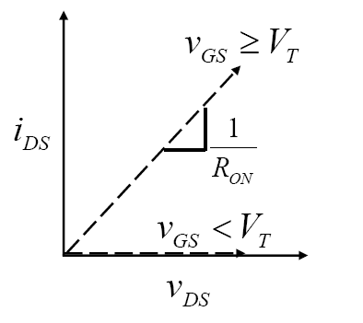
Switch Resistor (SR) Model of MOSFET
Better approximation

Slide 19
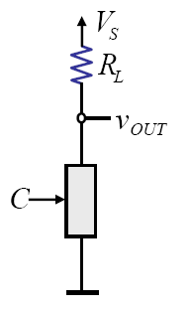
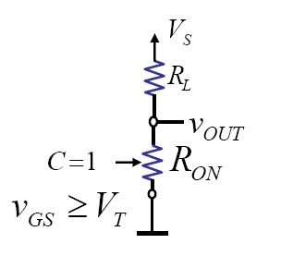
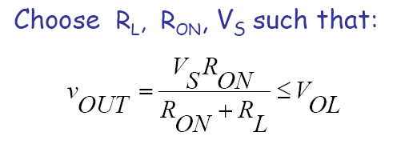
MOSFET Inverter: Revisted

Slide 20
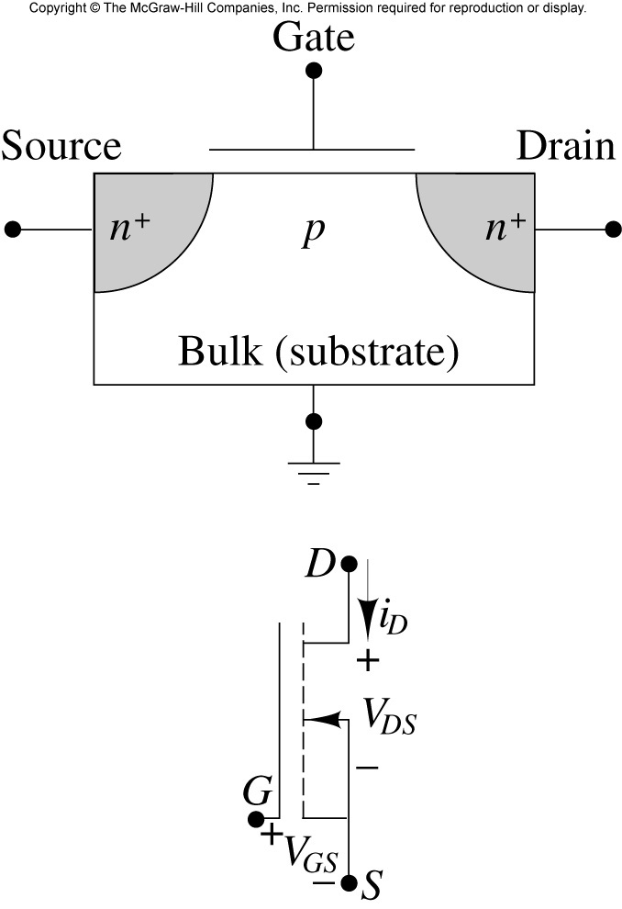
Physical Structure of MOSFET

Slide 21
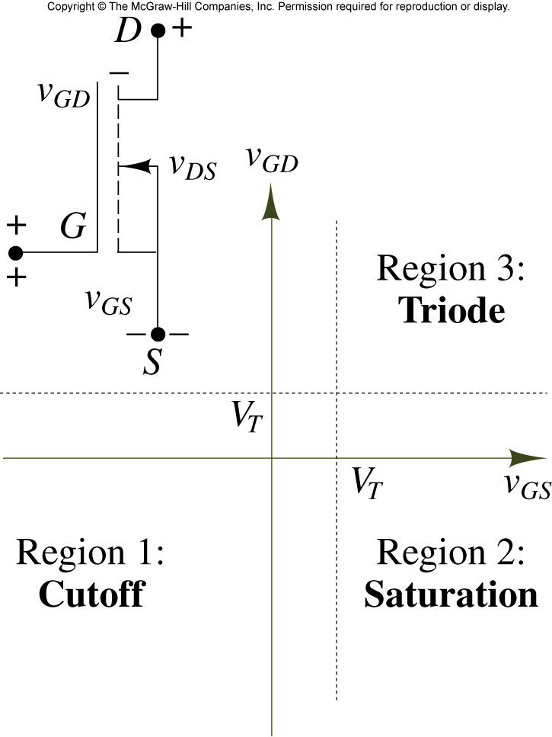
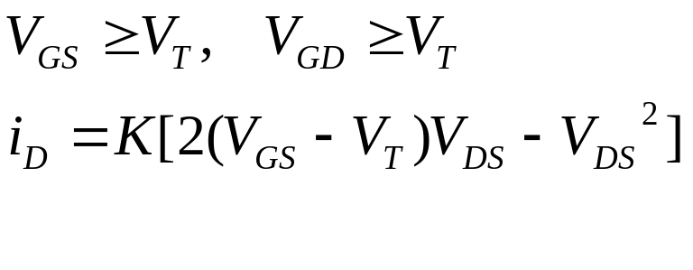
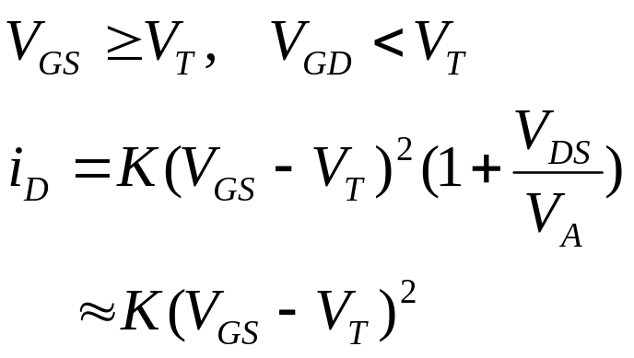
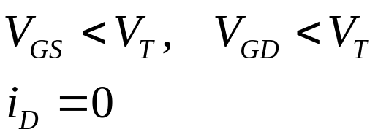
Regions of operation of NMOS transistor

Slide 22
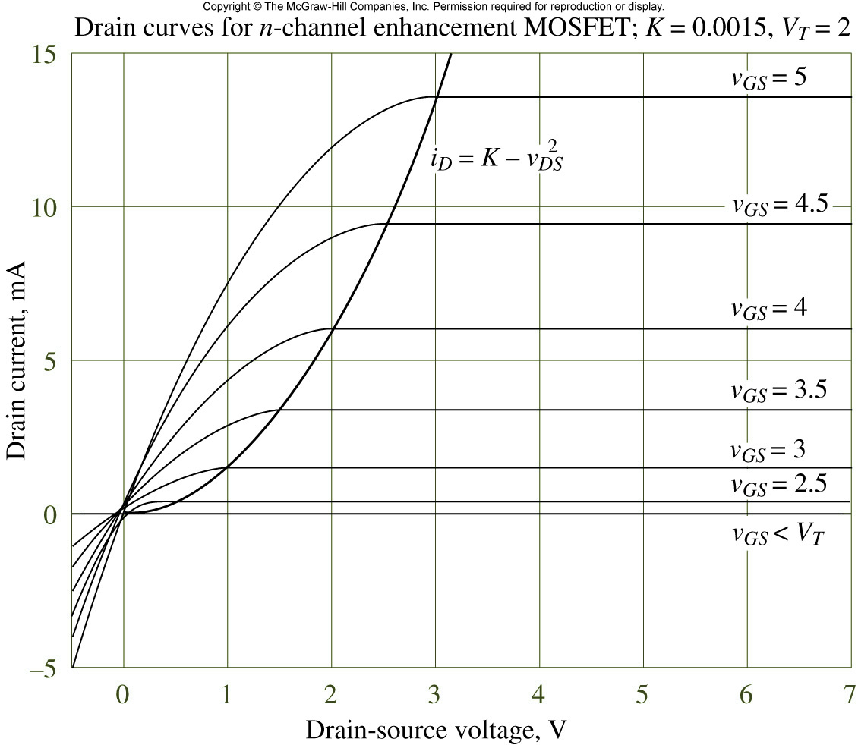
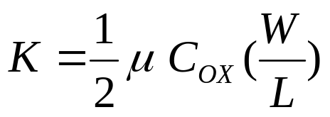
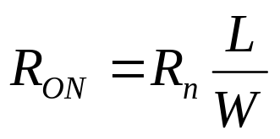
I-V Characteristic of NMOS
Conductance parameter

Slide 23

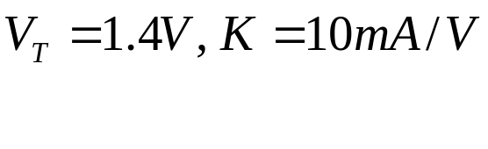



MOS Circuit Analysis

Slide 24
Inverter Characteristics: SR Model

Slide 25
Example 6.5
Determine W/L for correct inverter operation

Slide 26
Example 6.6
To satisfy the following static discipline redesign the inverter.

Slide 27
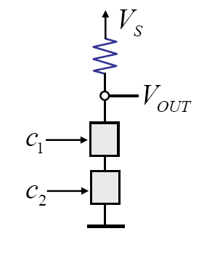
Static Analysis of NAND Gate: SR Model

Slide 28


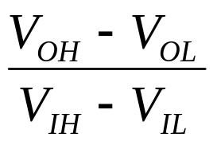
Signal Restoration and Gain
Noise 0.6 V
I
B
Buffer restores the signal level (example)
Gain =

Slide 29






Buffer Voltage Transfer Characteristics (VTC)

Slide 30



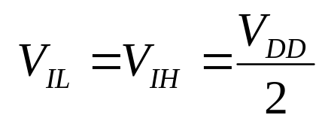
Inverter VTC
Ideal VTC

Slide 31
Conclusion
MOSFET and S Model
MOSFET and SR Model
MOSFET Analysis
Signal Restoration and Gain

